Slide 1
Graphiql demo

Slide 2
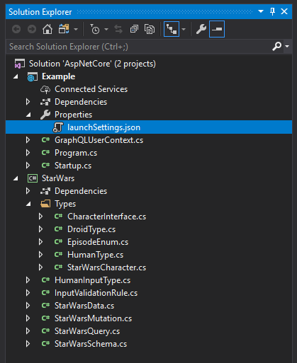
Note: Launch using Kestrel From Visual Studio: Start: Example (not IISExpress)
https://github.com/graphql-dotnet/examples/tree/master/src/AspNetCore

Slide 3
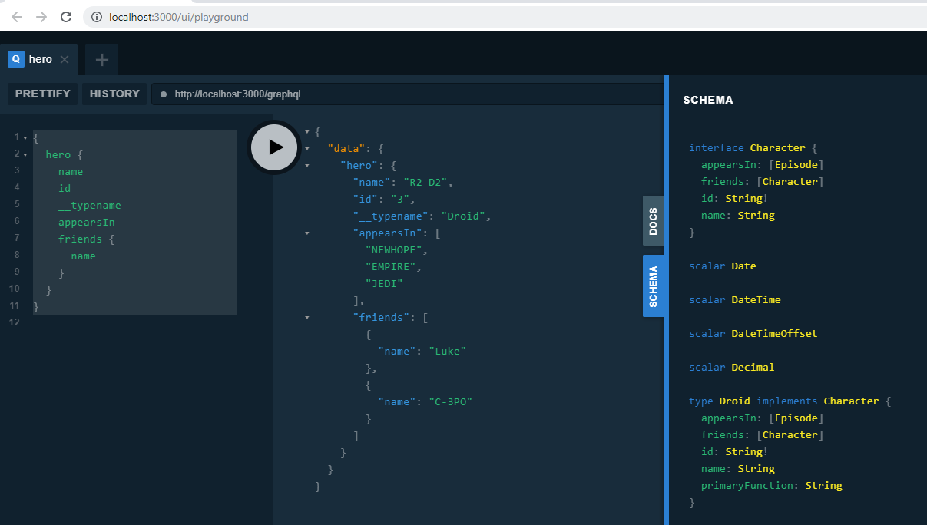

Slide 4
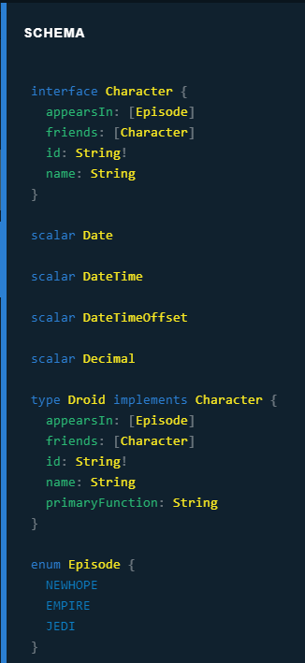
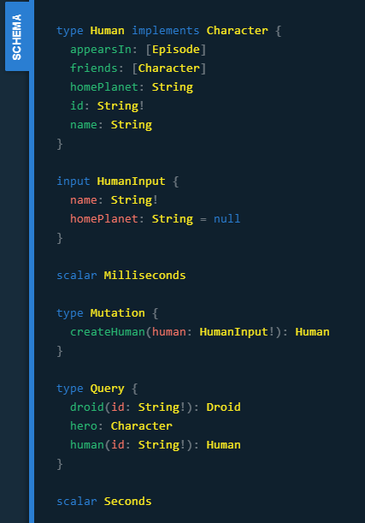

Slide 5
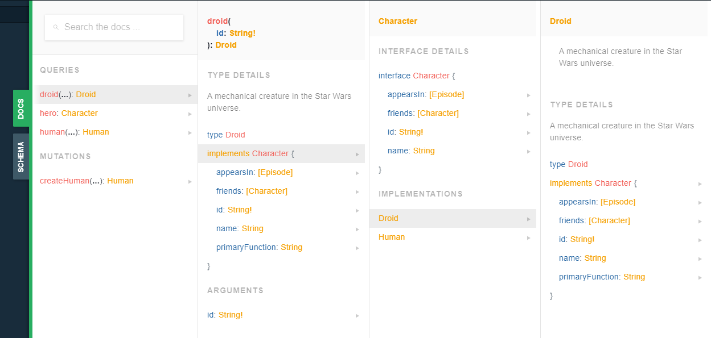

Slide 6
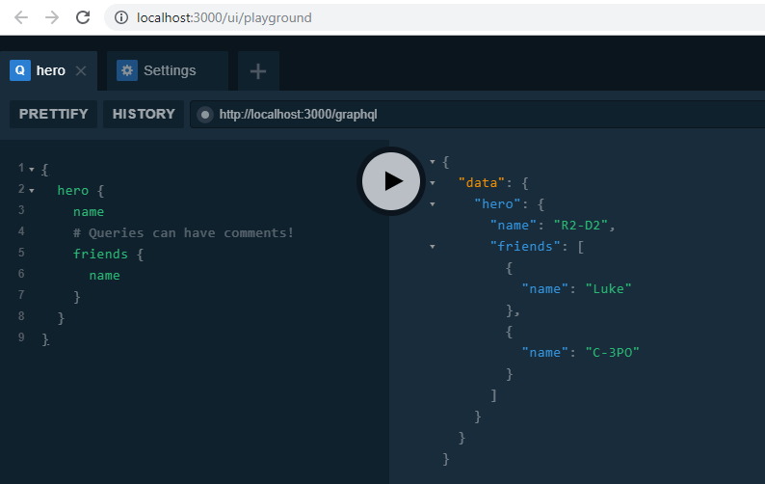
Fields
Notes:
https://graphql.org/learn/queries/#fields

Slide 7
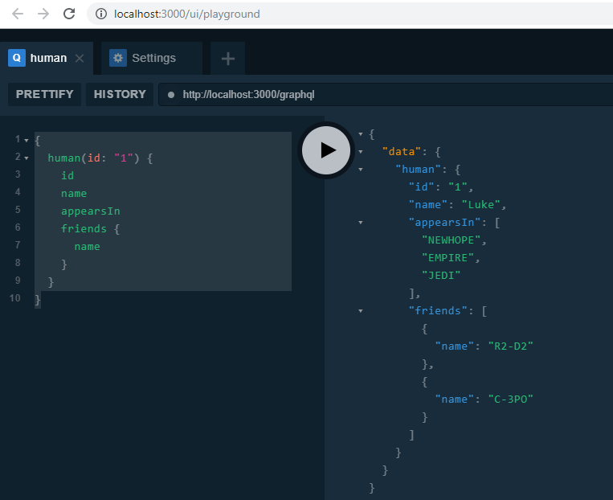
arguments
Notes:
https://graphql.org/learn/queries/#arguments

Slide 8
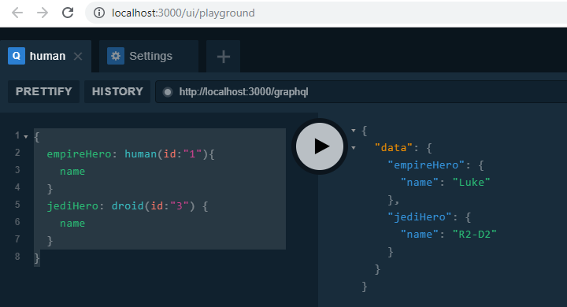
Aliases
Notes:
https://graphql.org/learn/queries/#aliases

Slide 9
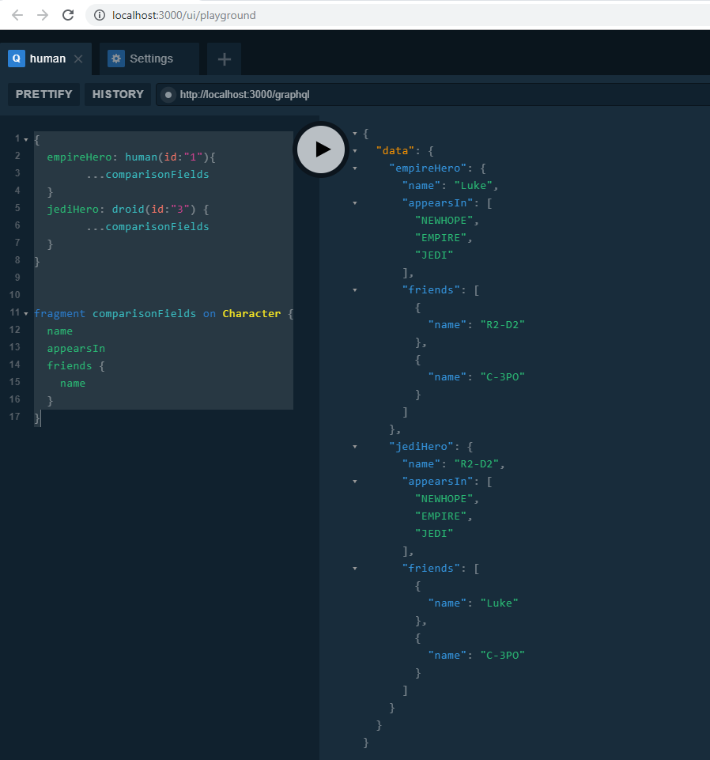
Fragments

Slide 10
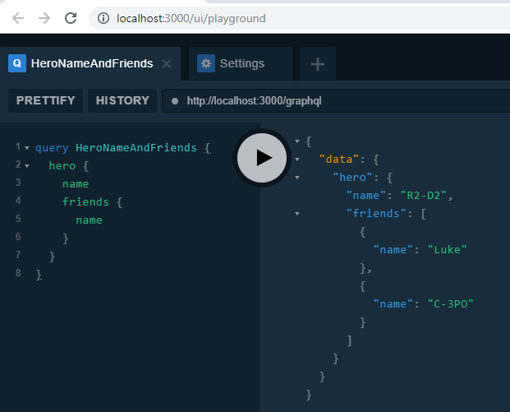
Operation name
Notes:
https://graphql.org/learn/queries/#operation-name

Slide 11
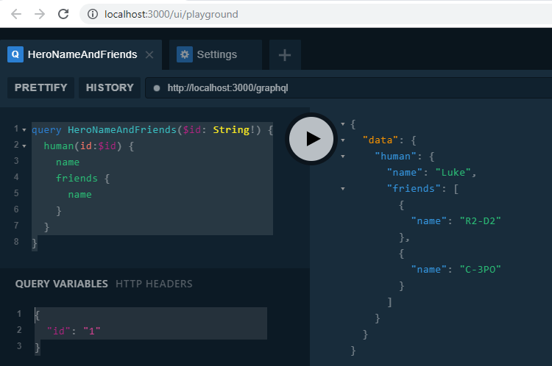
Variables
Notes:
https://graphql.org/learn/queries/#variables

Slide 12
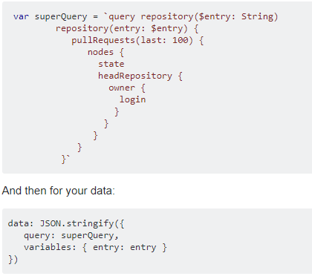
Variables: JQUERY nOTES
Notes:
https://stackoverflow.com/questions/45516743/how-can-i-send-a-graphql-ajax-query-with-a-variable

Slide 13
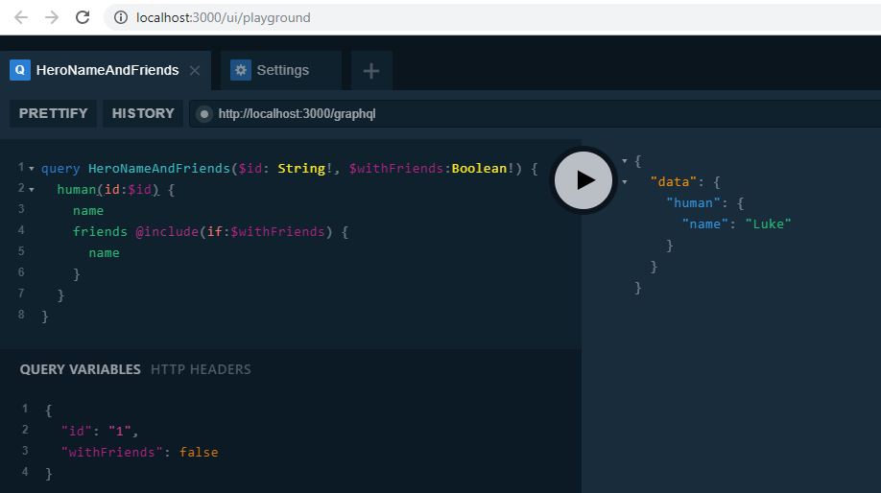

Directives #1
Notes:
https://graphql.org/learn/queries/#directives

Slide 14
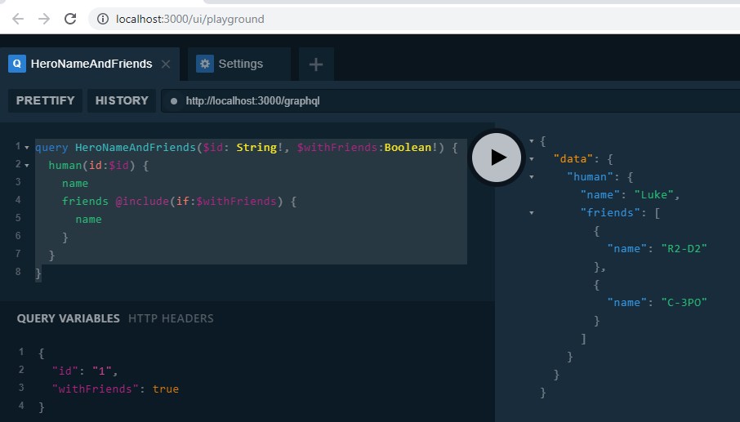
Directives #2

Slide 15
